Slide 1
Computer Graphics and Multimedia
Dr. Rajesh Siddavatam
Ph.D (BITS–Pilani)
Dean – Quality Assurance
Professor
www.srajesh.in
Mail: srajeshfcs@kiit.ac.in

Slide 2
Overview
Introduction, Context and applications
Graphics Pipeline and hardware
Raster Graphics : Design, analysis and implementation of data structures and algorithms
Algorithms for clipping
2D geometric transformations

Slide 3
Overview
Area filling
Viewing
3D object representations (Bezier curves and Surfaces)
Geometric and modeling transformations
3D viewing
Visible surface detection methods
Illumination models and surface rendering methods

Slide 4
Why Study Computer Graphics?
Graphics is cool
  I like to see what I’m doing
  I like to show people what I’m doing
Graphics is interesting
  Involves simulation, algorithms, architecture…
I’ll may/maynot get an Oscar for my acting
  But maybe I’ll get one for my CG special effects
Graphics is fun

Slide 5
Brief History - CG
1963 Evan Sutherland’s seminal doctoral work at MIT “Sketchpad: a man-machine graphical communication system”
1977 3D Core Graphics System by ACM SIGGRAPH Committee
1980’s, hardware expensive & graphics app. programs were few
1985 GKS (the Graphical Kernel System), 2D
1987 MIT’s X lib for windows under UNIX OS
1988 GKS-3D; SGI’s GL
1992 OpenGL (Open standard from SGI)
Since then, OpenGL supported on PC, MAC, Sun work-stations, SGI work-stations, special purpose image generators (ESIG)
Since then, Evolution of advanced GUI’s and graphics environments; Software from low-level, device dependent packages to higher-level device-independent packages
2003 JOGL – Java for OpenGL from Sunmicrosystem

Slide 6
Applications – CG
Science & Engineering: visualization, modeling, simulation
Medicine: medical imaging, surgery planning
Art, Commerce, Entertainment: galleries, games, ads,
film (Jurassic Park, Star Trek)
Computer-aided design (CAD): buildings, auto bodies,
airplane wings, VLSI chips, etc.
Office automation and electronic publishing
Information visualization

Slide 7
Objectives
Introduce basic graphics concepts
object, model, image, graphics library, frame buffer, scan-conversion, clipping, and anti-aliasing
Set up OpenGL programming environment
Understand simple OpenGL programs

Slide 8
Definition of Computer Graphics (CG)
CG displays or animates real or imaginary objects from their computer-based models;
  Modeling defined as creating and modifying a model
  Graphics can be interactive
User controls the creation, modification, and animation of the models through input devices (keyboard & mouse)

Slide 9
Object, Model and Image
A real or imaginary object is represented in a computer as a model, and is displayed as an image.
A model is an abstract description of the object’s shape (vertices) and attributes (colors),
  which can be used to find all the points on the object corresponding to the pixels in the drawing area.
  Given a model, the application program will control the pen through a graphics library to generate the corresponding image.
An image is simply a 2D array of pixels.

Slide 10
CG-Display
A graphics display is a drawing area comprised of an array of fine points called pixels (picture elements).
At the heart of a graphics system there is a magic pen,
  move at lightning speed to a specific pixel
  draw the pixel with a specific color — a red, green, and blue (RGB) vector value.
  Computer graphics is about using this pen automatically through programming.

Slide 11
The Basics
Main tasks:
  modeling: creating and representing the geometry of objects in the 3D world
  rendering: generating 2D images of the objects
  animation: describing how objects change in time

Slide 12
Primitives and OpenGL
A graphics library provides a set of graphics commands or functions.
  bound in C, Java, or other programming languages on different platforms.
  specify primitive 2D and 3D geometric models to be digitized and displayed.
Primitive models or simply primitives stand for some simple shapes (such as points, lines, and polygons)
OpenGL is a graphics library

Slide 13
Clipping – CG
Any procedure which identifies that portion of a picture which is either inside or outside a picture is referred to as a clipping algorithm or clipping.

Slide 14
Open GL ( www.opengl.org)
OpenGL is the most widely used graphics library (GL) or application programming interface (API )
Developed by Silicon Graphics – 1992
More details @ www.opengl.org
Need to use OpenGL for Lab

Slide 15
Graphics System: Framebuffer, Scan-conversion
Application
Keyboard
program
OpenGL
Computer and
Mouse
GLUT
Graphics hardware
Graphics
and
Frame
Video
C functions
buffer
controller
Display
models
The graphics system generates the image specified by the application program in the framebuffer and displays the picture on the display
The application program accepts user input and controls the graphics model (create, store, retrieve, modify, and send it to the graphics system)
The digitization process is called scan-conversion (drawing, rendering)

Slide 16
Mouse, keyboard for input, CRT (cathode ray
tube) for output (Other input/output devices)
Most of the programmer’s task concerns
creating and changing the model and handling user interaction
Models typically store descriptions of the
shapes, positions, attributes (color), and
hierachical relationships of the components
A graphics library includes output subroutines
of primitives and attributes, such as in OpenGL
glRecti(x1,y1,x2,y2) , glColor3f(r,g,b), etc.
glBegin(GL_POINTS);
glVertex2i (x,y);
glEnd();

Slide 17
The screen is a window for the user to manipulate not only the image, but also the model
A picture is produced as an array (raster) of
picture elements (pixels) saved in the framebuffer
The framebuffer corresponds to the CRT picture.
An event is a user input or other state change queued
with other events generated in timely order
Each event is handled in the queued order by
the system or user event handler (user program).

Slide 18
Complex Object and Animation
To draw a complex shape, we need an application program to dissect it into pieces of simple shapes (primitives), or construct it from primitives.
We have the magic pen that draws a pixel. If we can draw a pixel, we can draw a point, a line, a polygon, a curve, a surface, Solid
we can draw a complex object, clear the drawing area, draw the object at a slightly different location, and repeat the above processes — the object is animated.

Slide 19
How to draw a Point using Open GL
/* Example 1point.c: draw randomly generated points */
    #include <stdlib.h>
    #include <GL/glut.h>
    #define Height 400
    #define Width 400

Slide 20
    void display(void)
    {
    int x, y;
    //a. generate a random point
    x = rand() % Width;
    y = rand() % Height;
    //b. specify a drawing color: red
    glColor3f(1, 0, 0);
    //c. specify to draw a point
    glBegin(GL_POINTS);
    glVertex2i (x,y);
    glEnd();
    //d. start drawing
    glFlush();
    }

Slide 21
    static void reshape(int w, int h)
    { //e. specify the window’s coordinates
      glMatrixMode (GL_PROJECTION);
      glLoadIdentity ();
      glOrtho(0, Width, 0, Height, -1.0, 1.0);
    }
    int main(int argc, char **argv)
    { //f. initialize a drawing area
    glutInit(&argc, argv);
    glutInitDisplayMode(GLUT_SINGLE);
    glutInitWindowSize(Width, Height);
    glutCreateWindow("Example 1.1.point.c");
      //g. specify event callback functions
      glutReshapeFunc(reshape);
      glutDisplayFunc(display);
      glutIdleFunc(display);
      glutMainLoop();
    }

Slide 22
CG Lab Exercise - 1
Set up your programming environment, and run the first sample program that draws a point (or randomly generated points).

Slide 23
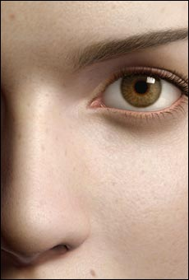
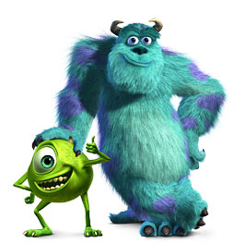
Graphics Applications
Entertainment: Cinema
Square: Final Fantasy
Pixar: Monster’s Inc.

Slide 24
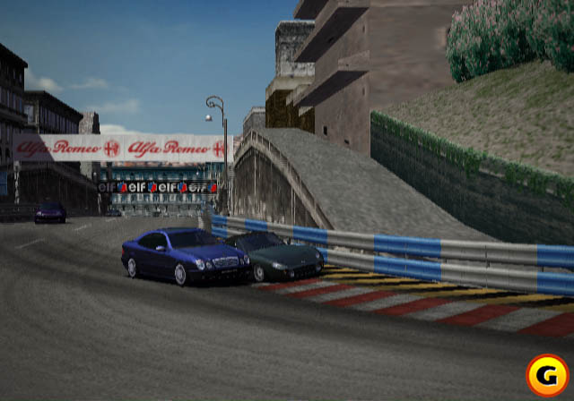
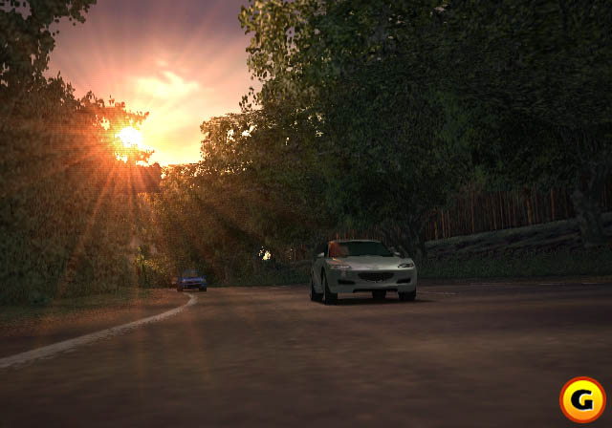
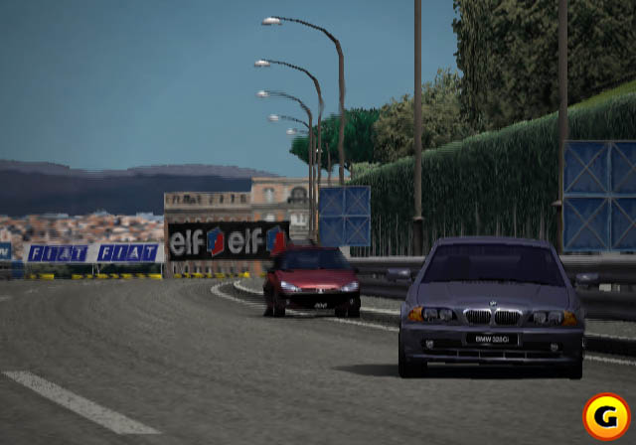
Graphics
Applications
Entertainment: Games
GT Racer 3
Polyphony Digital: Gran Turismo 3, A Spec

Slide 25
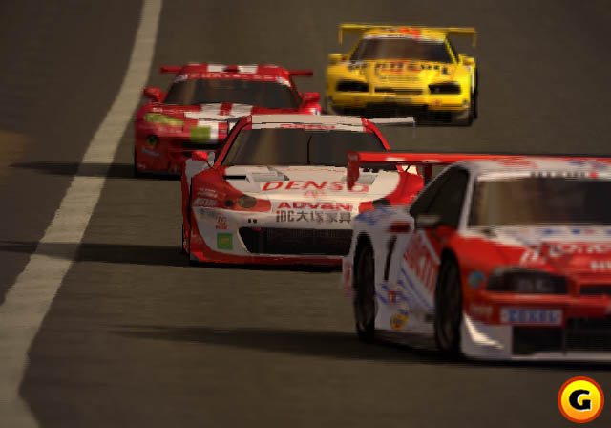
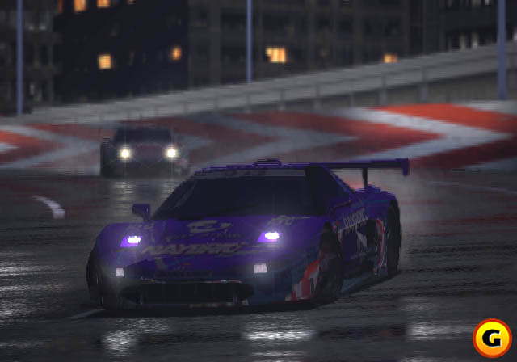
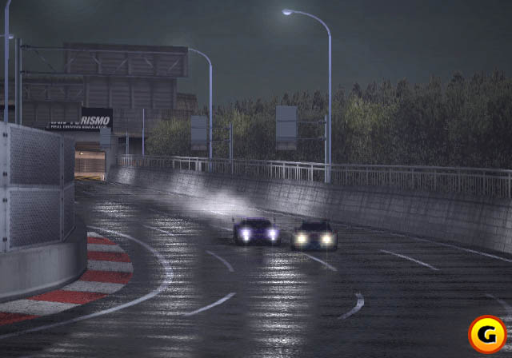
Graphics
Applications
Video Games

Slide 26
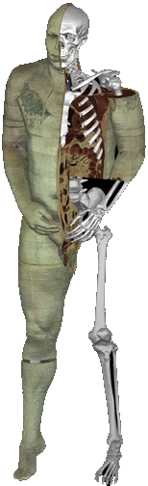
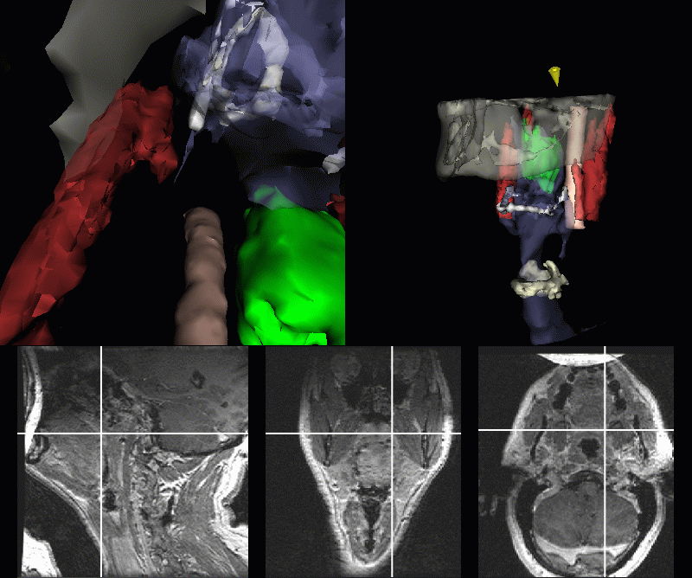
Graphics Applications
Medical Visualization
The Visible Human Project
MIT: Image-Guided Surgery Project

Slide 27
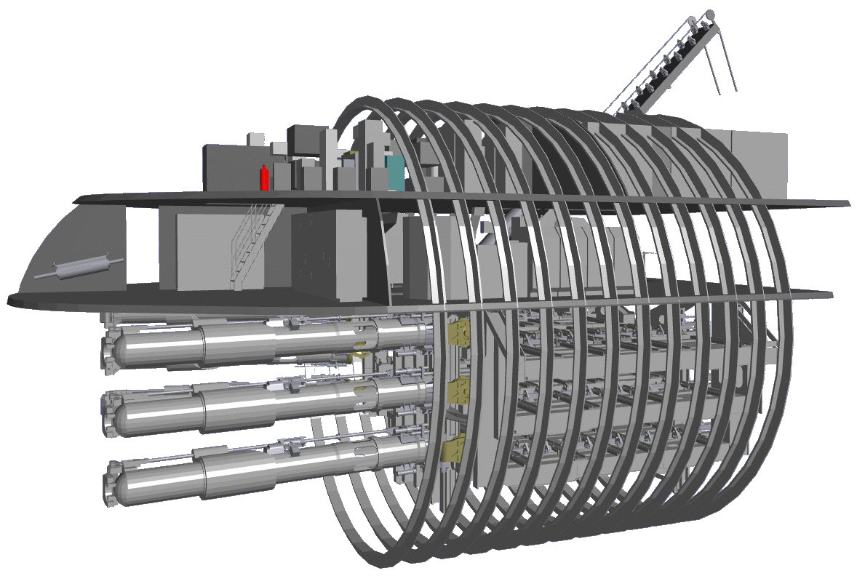
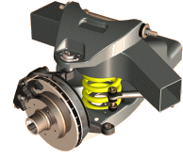
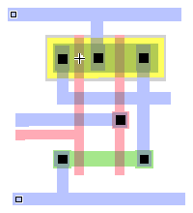
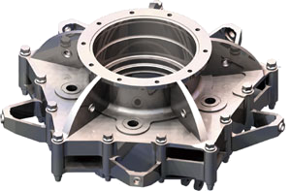
Graphics Applications
Computer Aided Design (CAD)

Slide 28
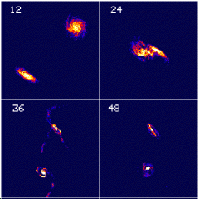
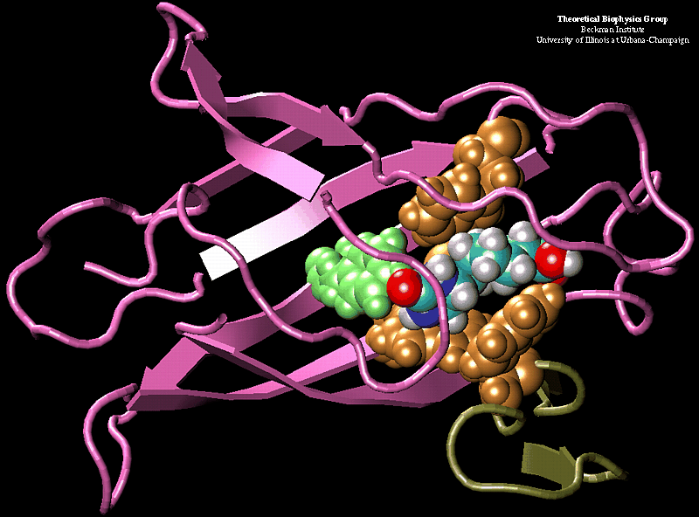
Graphics Applications
Scientific Visualization

